Slide 1
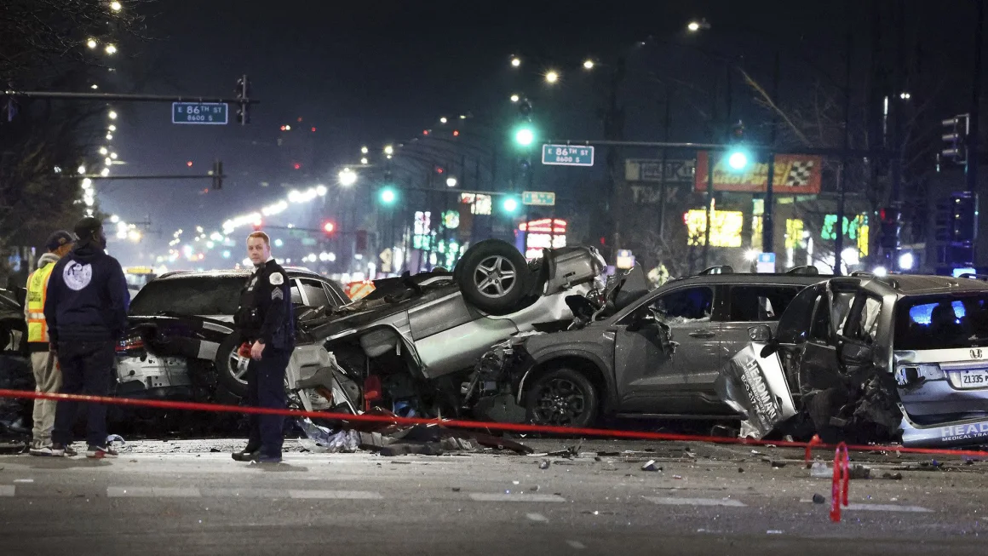
Predicting Traffic Accident Damage Severity Using Machine Learning Models
Predicting Traffic Accident Damage Severity Using Machine Learning Models
Data Science Project – Statistical Modelling for Data Science Course
Sarthak Sunil Dhanke
12/12/2024
Sarthak Sunil Dhanke
12/12/2024

Slide 2
Executive Summary
Executive Summary
Objective: Developed a machine learning model to predict accident damage severity (High/Low) using historical data.
Approach: Analyzed 2024 Chicago accident data; implemented Logistic Regression, Random Forest, and Gradient Boosting models.
Challenges: Managed class imbalance, cleaned extensive categorical data, and balanced interpretability with accuracy.
Results: Though Gradient Boosting achieved the highest accuracy at 72%, generalization remained poor.
Learnings: Class imbalances in the data significantly reduces the predictive power regardless of the model used.
Next Steps: Incorporate location-based data to identify high-risk zones and use alternative techniques to further address class imbalances to improve the predictive power of the model

Slide 3
Agenda
Agenda
Problem Statement
Assumptions and Hypotheses
Data Properties and Exploratory Analysis
Data Cleaning and Feature Engineering
Methodology and Models
Results and Learnings
Future Directions

Slide 4
Motivating the Study of Traffic Accident Damage Severity
Problem Statement
Context: Chicago faces a persistent challenge with road safety, with thousands of crashes occurring annually causing significant economic and social losses.
Key problem areas:
High injury severity rates: Many accidents result in fatalities or incapacitating injuries.
Data-driven insights lacking: Limited understanding of the factors contributing to severe accidents hinders effective interventions.
Need for predictive models: Existing safety strategies often rely on reactive measures instead of proactive, evidence-based decisions.
Objective:
Develop a predictive model to analyze accident severity, enabling policymakers to identify and address critical factors influencing severe outcomes.

Slide 5
Agenda
Agenda
Problem Statement
Assumptions and Hypotheses
Data Properties and Exploratory Analysis
Data Cleaning and Feature Engineering
Methodology and Models
Results and Learnings
Future Directions

Slide 6
Assumptions and Hypotheses Underpinning the Study
Assumptions and Hypotheses
Assumptions:
Data Accuracy: The dataset from Chicago's Traffic Crash Reporting System is complete, consistent, and free of significant reporting bias.
Predictive Relationships Exist: Factors like weather, lighting, and traffic conditions are assumed to have measurable relationships with accident severity.
Independence of Observations: Each recorded accident is treated as an independent event.
Feature Impact: Selected features such as traffic controls, road alignment, and weather conditions significantly influence accident severity.
Hypotheses:
Environmental Factors: Adverse weather (rain, snow) increases the likelihood of severe accidents.
Roadway Features: Areas with poor alignment or inadequate controls correlate with higher severity rates.
Driver Behavior: Primary contributory causes (e.g., speeding, distracted driving) are strongly predictive of severity.
Temporal Trends: Certain times of the day (e.g., rush hours) are associated with increased severity of accidents.
Goal: Utilize these hypotheses to identify critical patterns, enabling actionable insights for traffic safety improvements.

Slide 7
Agenda
Agenda
Problem Statement
Assumptions and Hypotheses
Data Properties and Exploratory Analysis
Data Cleaning and Feature Engineering
Methodology and Models
Results and Learnings
Future Directions

Slide 8
Understanding the Traffic Accident Dataset
Data Properties and Exploratory Analysis
The dataset used for the analysis is provided by the Chicago Traffic Crash Reporting System and includes data on traffic accidents in the city in 2024; contains over 100,000+ accident records
Outcome Variable: DAMAGE (Damage to Public Property measured as dollars spend in restoration)
Predictors
Environmental WEATHER_CONDITION: Weather impacts road conditions, visibility, and driver behavior. LIGHTING_CONDITION: Poor lighting can lead to more severe crashes. ROAD_DEFECT: Specific defects can amplify the severity of a crash.
Crash Dynamics POSTED_SPEED_LIMIT: Higher speed limits often correlate with more severe crashes. NUM_UNITS: The number of vehicles or other units involved could impact damage severity.
Contributing Factors PRIM_CONTRIBUTORY_CAUSE: Primary reason for the crash as judged by the officer. SEC_CONTRIBUTORY_CAUSE: Secondary reason that contributed to the crash.
Temporal CRASH_HOUR: Time of day can affect traffic density and driver alertness. CRASH_DAY_OF_WEEK: Day of the week might reflect traffic patterns (e.g., weekends vs. weekdays).

Slide 9
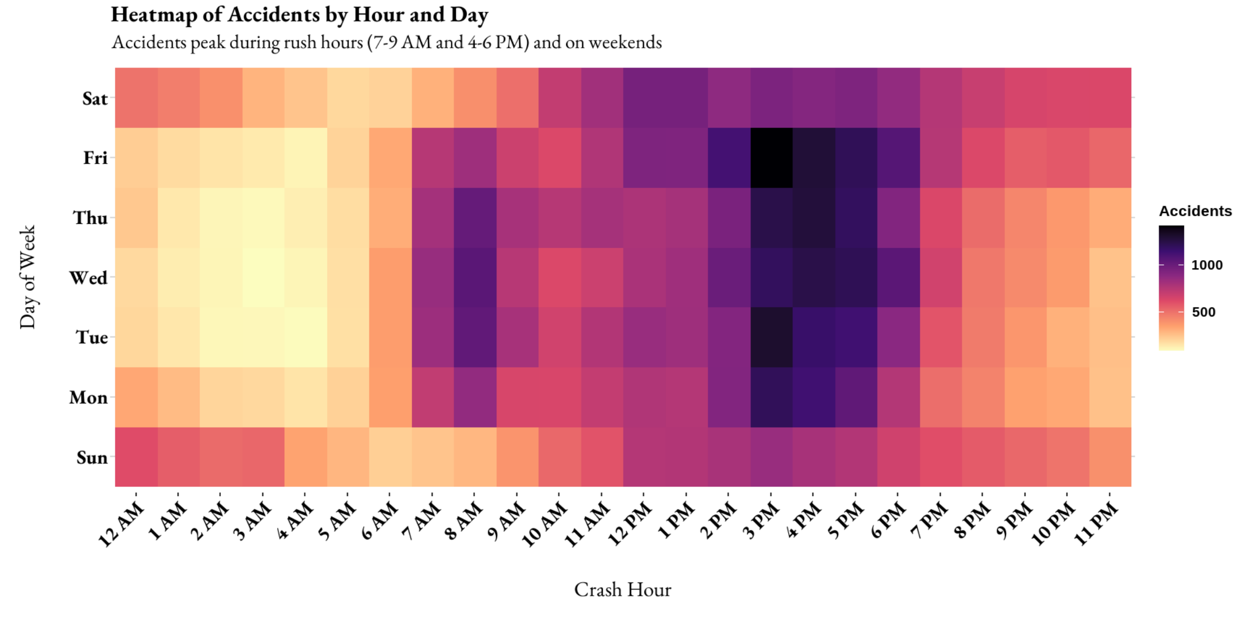
Accident Patterns by Time and Day
Exploratory Data Analysis & Feature Engineering

Slide 10
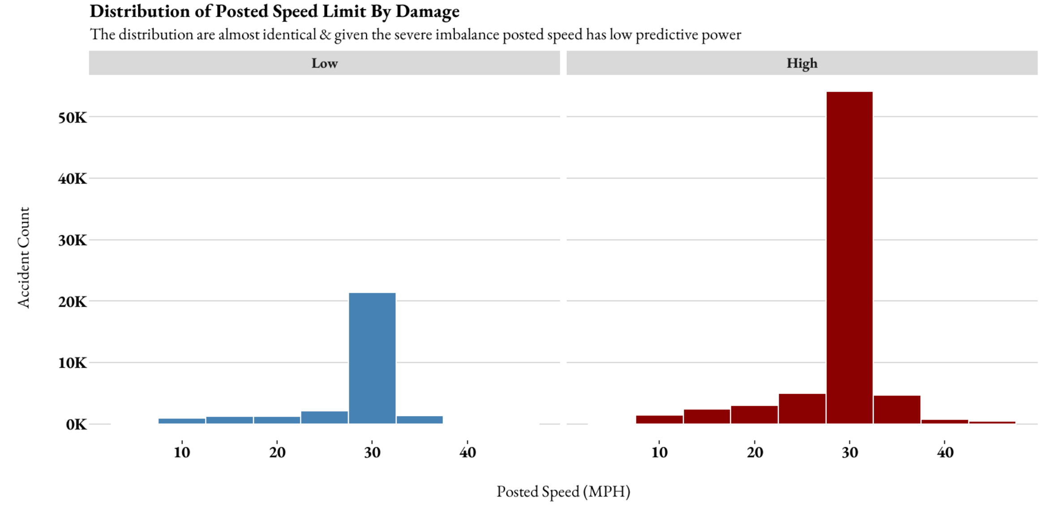
Speed Limit Distribution and Its Relationship to Damage Levels
Exploratory Data Analysis & Feature Engineering

Slide 11
Agenda
Agenda
Problem Statement
Assumptions and Hypotheses
Data Properties and Exploratory Analysis
Data Cleaning and Feature Engineering
Methodology and Models
Results and Learnings
Future Directions

Slide 12
Simplifying Categories for Better Predictive Power
Exploratory Data Analysis & Feature Engineering
Observations Leading to Grouping:
Imbalanced Distribution: Majority of data concentrated in a few classes, e.g., “Clear Weather” and “Low Damage.”
Sparse Categories: Some classes had too few samples to meaningfully contribute to modeling.
Complexity and Noise: High granularity in certain variables added unnecessary complexity and noise.
Benefits of Grouping:
Balanced class representation for training.
Improved computational efficiency by reducing sparsity.
Easier interpretation of results through broader, intuitive categories.
Key Message: Aggregating sparse and imbalanced categories in predictors and the target variable enhanced model accuracy, interpretability, and efficiency.

Slide 13
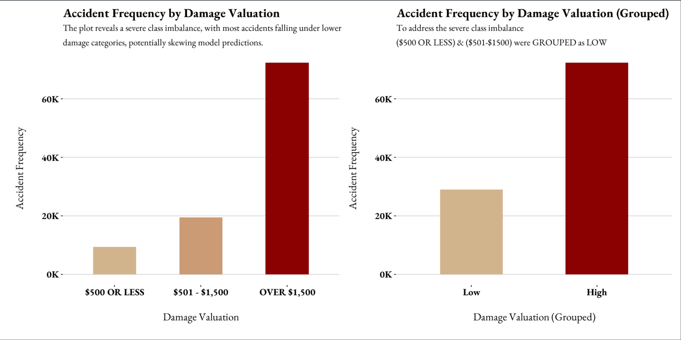
Simplifying Categories for Better Predictive Power
Exploratory Data Analysis & Feature Engineering

Slide 14
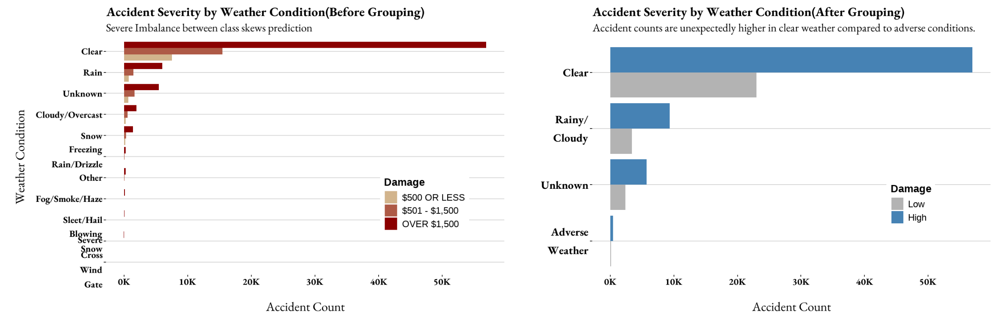
Simplifying Categories for Better Predictive Power
Exploratory Data Analysis & Feature Engineering

Slide 15
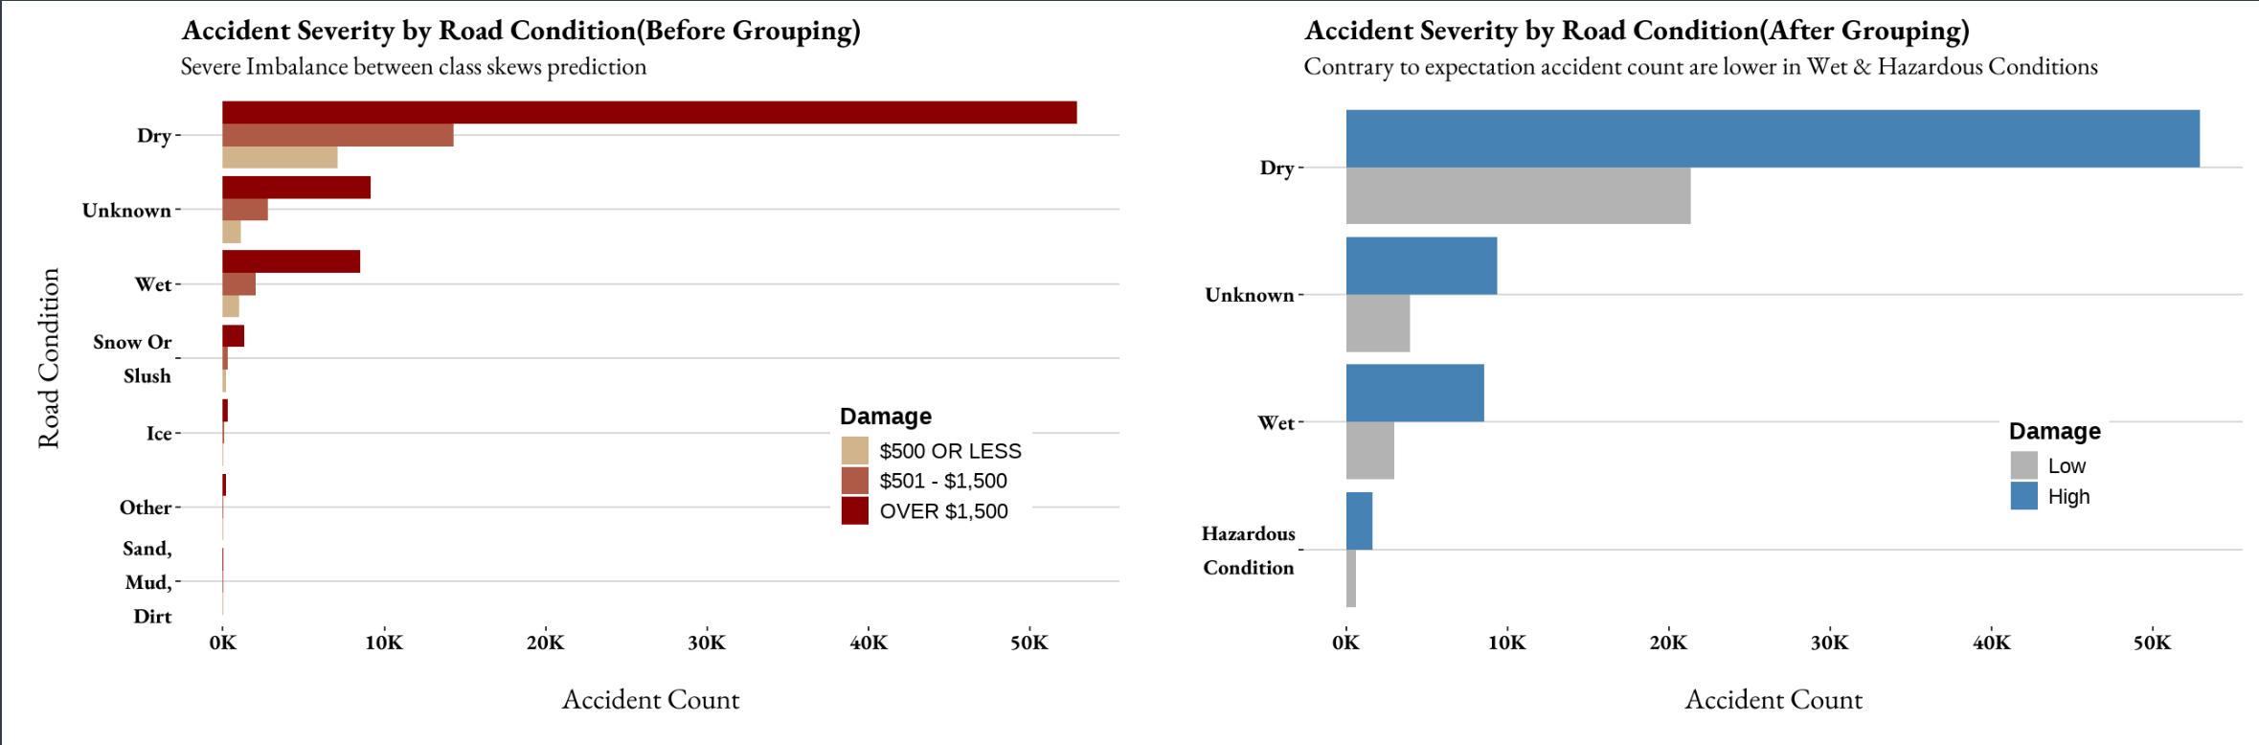
Simplifying Categories for Better Predictive Power
Exploratory Data Analysis & Feature Engineering

Slide 16
Simplifying Categories for Better Predictive Power
Exploratory Data Analysis & Feature Engineering
Variable Name | Original Categories | Grouped Categories | Reason for Grouping
damage (Target) | Multiple levels of severity | High and Low | Class imbalance and interpretability.
weather_condition | Specific conditions (e.g., "Fog," "Rain") | Adverse, Clear, Rainy | Sparse classes and imbalance.
lighting_condition | Multiple light conditions | Daylight, Darkness, Twilight | Simplified feature engineering.
road_surface_condition | Multiple surface states | Dry, Wet, Hazardous, Unknown | Improve model efficiency.
num_units | Number of units affected | 1unit , 2 unit, +3 unit | Sparse classes and imbalance.
prim_cond | Causes for accidents as noted by office | Few High-Level Categories | Reduce noise from sparse data

Slide 17
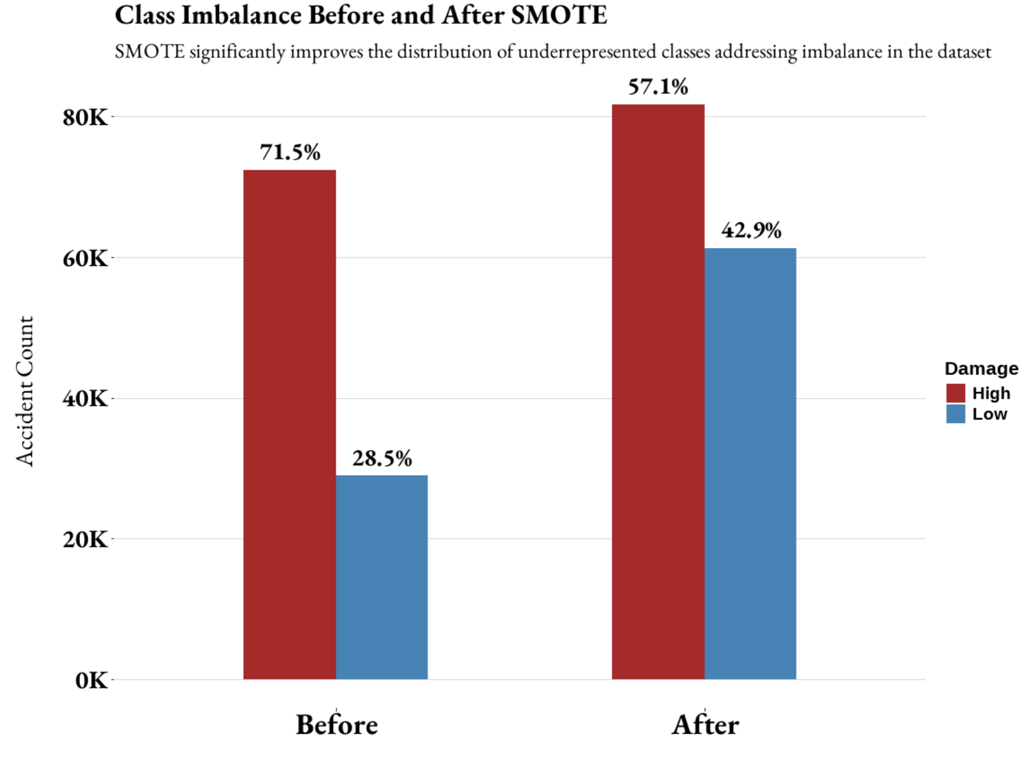
Balancing the Scales for Improved Predictions
Exploratory Data Analysis & Feature Engineering
Challenge: Simplifying categories alone does not resolve the issue of severe class imbalance in predictors and target variables.
Solution: Implemented Synthetic Minority Oversampling Technique (SMOTE) to create a balanced dataset.
SMOTE generates synthetic samples for underrepresented classes.
Ensures better representation of all classes, enhancing model learning.
Outcome: Improved class distribution and more equitable model performance metrics.
Key Message: "Balancing the dataset using SMOTE helps ensure that the model learns equitably from all classes, addressing inherent biases caused by imbalance."

Slide 18
Agenda
Agenda
Problem Statement
Assumptions and Hypotheses
Data Properties and Exploratory Analysis
Data Cleaning and Feature Engineering
Methodology and Models
Results and Learnings
Future Directions

Slide 19
Evaluating Different Machine Learning Techniques
Proposed Models
Model | Characteristics | Strengths | Weaknesses
Logistic Regression | Linear model; interpretable coefficients; assumes linear relationships. | Simple, interpretable, fast training. | Struggles with non-linear data.
Random Forest | Ensemble of decision trees using bootstrapped datasets and random feature selection. | Robust to overfitting, handles non-linearity. | Computationally expensive for large datasets.
Gradient Boosting | Sequentially builds models to minimize errors using a boosting framework. | High accuracy for complex relationships. | Requires parameter tuning; slower training.
LightGBM | Gradient boosting framework with optimized algorithms for fast computation and handling large datasets. | Scales well; handles categorical features. | Sensitive to overfitting if not tuned.
We selected models balancing simplicity, interpretability, and the ability to handle imbalanced and complex data.

Slide 20




Logistic Regression Model Selection & Testing
Proposed Models
Model Development with Predictors & Interactions
Model Refinement with Stepwise Selection
Model Evaluation on Unseen Data
Assumption Checks for Model Validity

Slide 21
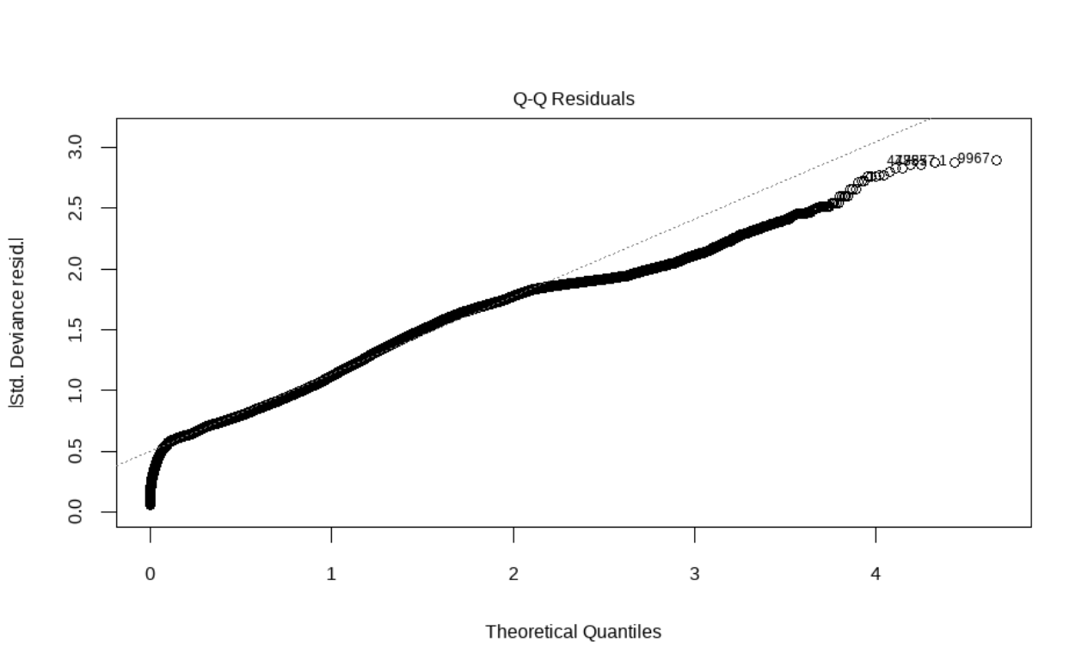
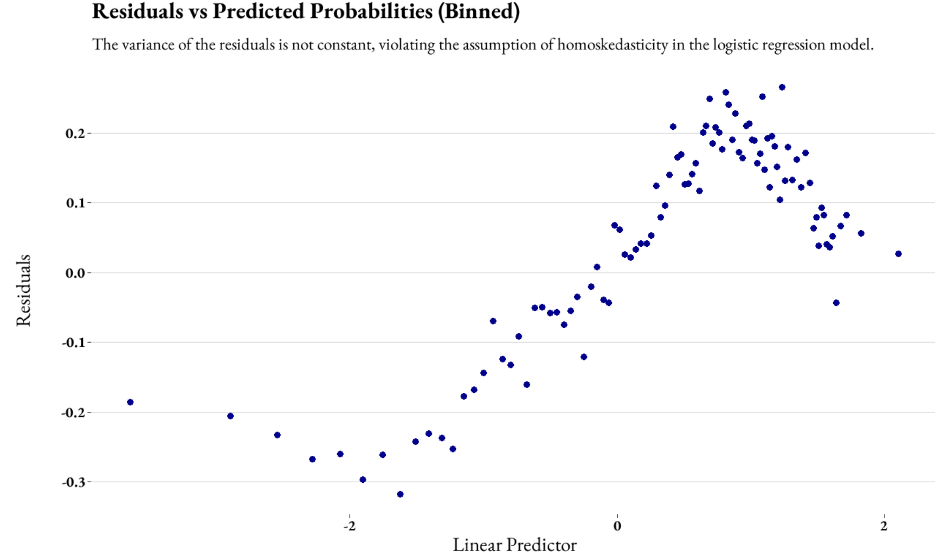
Checking Model Assumptions
Learnings
The variance of residuals is not constant, violating the assumption of homoskedasticity in the model.
The residuals are not normally distributed, deviating from the ideal value as they increase.

Slide 22
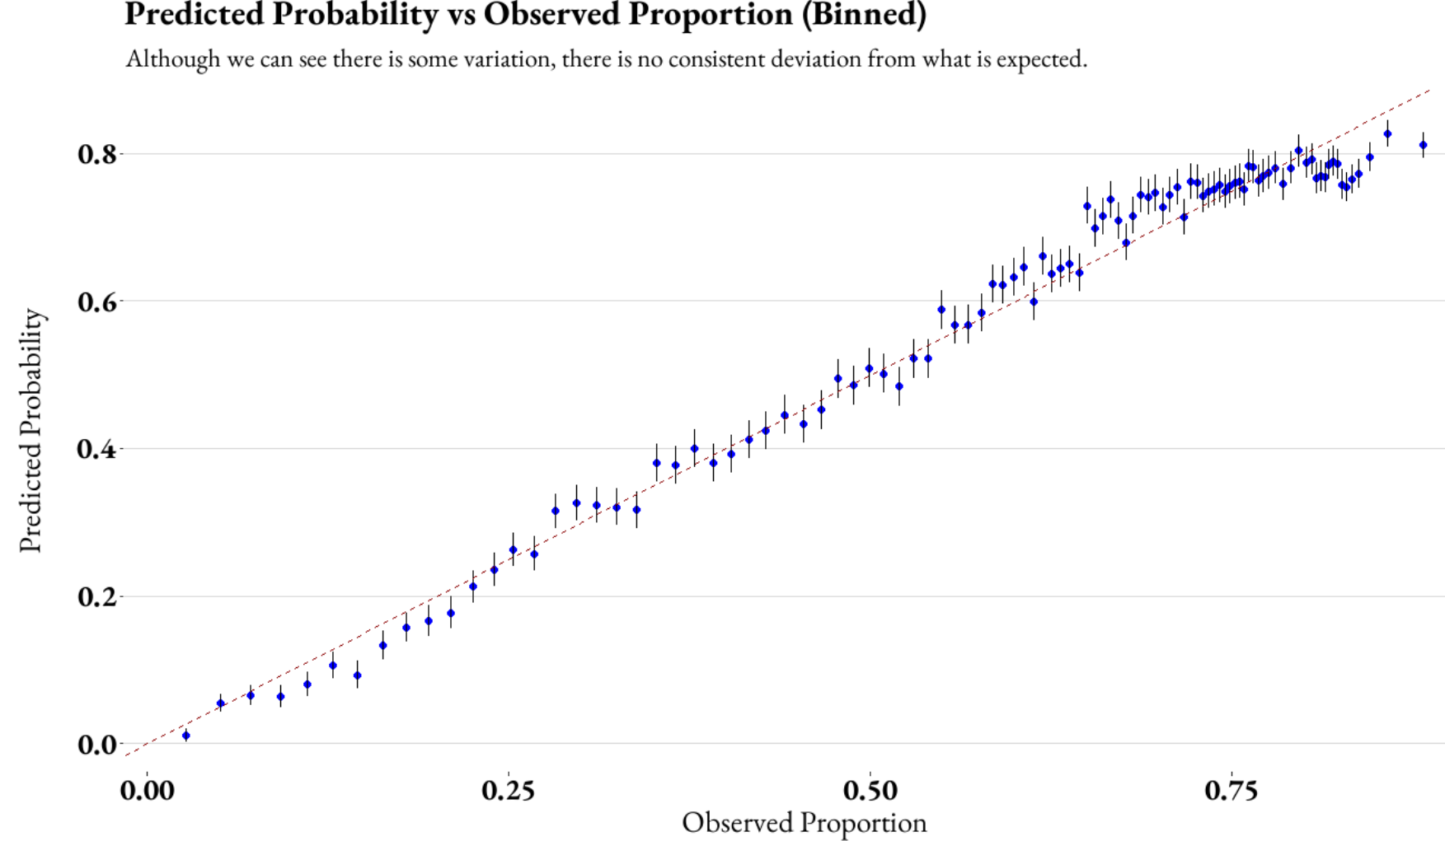
Evaluating Predicted vs. Observed Probabilities
Testing Goodness of Fit
Statistic | Value
Hosmer-Lemeshow (HL) | 850
Degrees of Freedom | 100
p-value | 0
Conclusion:
The predicted probabilities closely align with observed proportions, validating the model's calibration, except for minor deviations at the extremes.
However, the Hosmer-Lemeshow statistic indicates significant lack of fit (p-value = 0), suggesting room for model improvement.

Slide 23
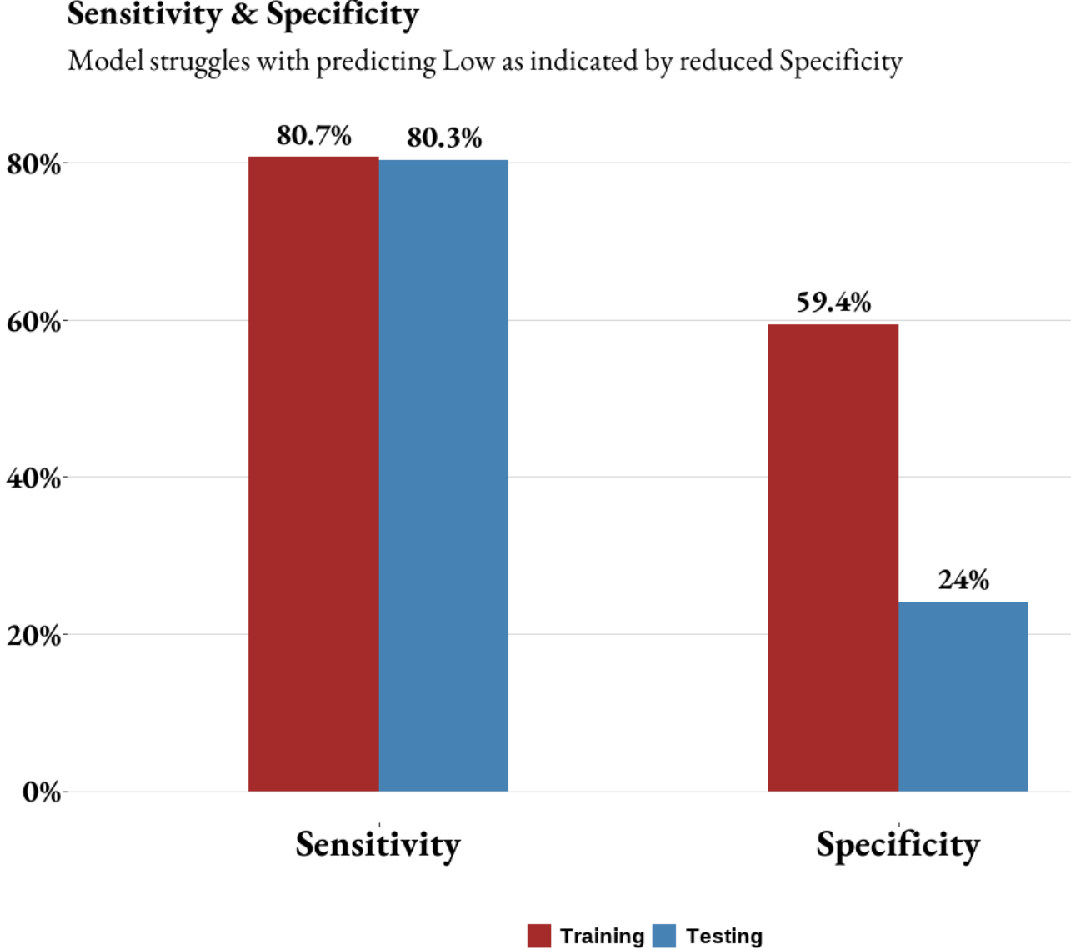
Optimal Threshold Selection and Evaluation
Selecting Optimal Threshold
Goal : Accurately predict "High" instances (True Positives) while minimizing misclassification of "Low" as "High" (False Positives).
Threshold chosen: 0.55 (determined from ROC curve analysis).
Balances Sensitivity (True Positive Rate) and Specificity (True Negative Rate).
Prioritizes Sensitivity to correctly classify the majority class ("High").
Explanation for Low Specificity in Test Results
Class Imbalance Effect : "High" is overrepresented in the dataset (70%),
Threshold Optimization: Maximizes sensitivity, inevitably reducing specificity
Model Overfitting or Data Variability: Specificity in training might be inflated due to familiarity with the data

Slide 24
Performance Metrics Across Models
Results and Insights
Model | Accuracy | F1-Score | Sensitivity | Specificity
Logistic Regression | 0.65 | 0.77 | 0.80 | 0.24
Random Forest | 0.68 | 0.80 | 0.89 | 0.14
XGBoost | 0.72 | 0.83 | 0.96 | 0.08
LightGBM | 0.72 | 0.83 | 0.97 | 0.06
Sensitivity (Recall): Test data sensitivity was much lower (~0.05-0.09) compared to training (~0.32-0.71), indicating overfitting.
Specificity: High and consistent specificity in both datasets, showing bias towards the majority class.
Accuracy: Similar accuracy across test and train data, but sensitivity highlights poor generalization.
Balanced Metrics: Test data F1-score and Balanced Accuracy were much lower, reflecting poor handling of minority classes.

Slide 25
Agenda
Agenda
Problem Statement
Assumptions and Hypotheses
Data Properties and Exploratory Analysis
Data Cleaning and Feature Engineering
Methodology and Models
Results and Learnings
Future Directions

Slide 26
Potential Financial Impact of Predicting High-Cost Accidents
Quantifying the Impact of the Model
Metric | Value
Total Accidents per Year | 100,000
High-Cost Accidents (70%) | 70,000
Predicted Reduction in High-Cost Accidents (5%) | 3,500
Average Cost per High-Cost Accident | $1500
Estimated Annual Savings | $5.25 Million
Formula Used: To estimate the savings from predicting high-cost accidents, we applied the following formula:
Estimated Annual Savings=(Number of High-Cost Accidents Predicted)×(Average Cost per High-Cost Accident)
Where:
Number of High-Cost Accidents Predicted is based on the reduction in high-cost accidents (5% reduction of 3,500).
Average Cost per High-Cost Accident is assumed to be $1500.
By predicting high-cost accidents, the model could lead to $5.25 million in savings annually, showcasing the model's potential to reduce financial loss from traffic accidents.

Slide 27
What We Learned from the Study
Learnings
Data Preprocessing Determines Success: High-quality preprocessing, including handling missing values, addressing class imbalance, and feature engineering, significantly impacted model performance and interpretability.
Class Imbalance Challenges Predictive Power: Severe class imbalance reduced F1-Score and Recall for models like LightGBM and XGBoost, highlighting the need for techniques like SMOTE.
Influence of Weather and Traffic Conditions: Adverse weather and traffic-related predictors emerged as crucial, underscoring their impact on accident severity.
Model Performance vs. Interpretability: While ensemble methods provided higher accuracy, simpler models (e.g., Logistic Regression) offered actionable insights and better focus on minority classes.
Feature Simplification Adds Value: Grouping predictor categories helped improve interpretability but did not fully address imbalance without additional adjustments.

Slide 28
Expanding the Scope for Greater Impact
Future Work
Incorporate Spatial Variables: Add location-based features to predict high-risk accident zones, improving resource allocation and targeted interventions.
Enhance Class Balance Handling: Use advanced ensemble methods (e.g., stacking, boosting) to better handle class imbalance, reduce overfitting and improve model robustness
Explore Real-Time Prediction: Implement real-time accident prediction using streaming data for proactive incident management and timely interventions.
Key Message: The future of this project lies in expanding its capabilities to make more informed, dynamic predictions that can have a real-time impact on traffic safety and accident prevention.

Slide 29
Conclusions
Conclusion
Summary of Approach: This project utilized machine learning techniques , including XGBoost and
Logistic Regression to predict whether an accident would result in high or low damage (cost above or below $1500).
Results:
Logistic Regression emerged as the most effective model, since it was better at balancing sensitivity and specificity despite a lower accuracy that other complex models.
By predicting high-cost accidents, we could potentially save $5.25 million annually.
Key Learnings:
Simplifying categories and addressing class imbalance (using SMOTE) are crucial steps in improving predictive power.
This model showcases the importance of using predictive analytics in real-time traffic safety management, improving decision-making for road maintenance, law enforcement, and accident prevention.
Call to Action:
Expanding this work can lead to further savings and a reduction in traffic-related injuries and fatalities.
Future work should focus on incorporating spatial data for high-risk zone prediction and exploring real-time accident prediction.

Slide 30
Agenda
Agenda
Problem Statement
Assumptions and Hypotheses
Data Properties and Exploratory Analysis
Data Cleaning and Feature Engineering
Methodology and Models
Results and Learnings
Future Directions

Slide 31
Recommendations
Recommendations
Guide Enforcement Agencies: Use the model to allocate resources efficiently in areas with a higher likelihood of costly accidents. For example, targeted interventions can be deployed where the model predicts higher damage.
Public Awareness Campaigns: Leverage the findings to inform the public about accident risks based on weather conditions and speeding. Raising awareness can reduce accidents by promoting safer driving habits.
Enhance Data Collection: Encourage further collection of detailed traffic and environmental data, including spatial and real-time factors. Improved data can lead to more accurate models and better accident prevention.

Slide 32
Questions ?

Slide 33
Appendix

Slide 34
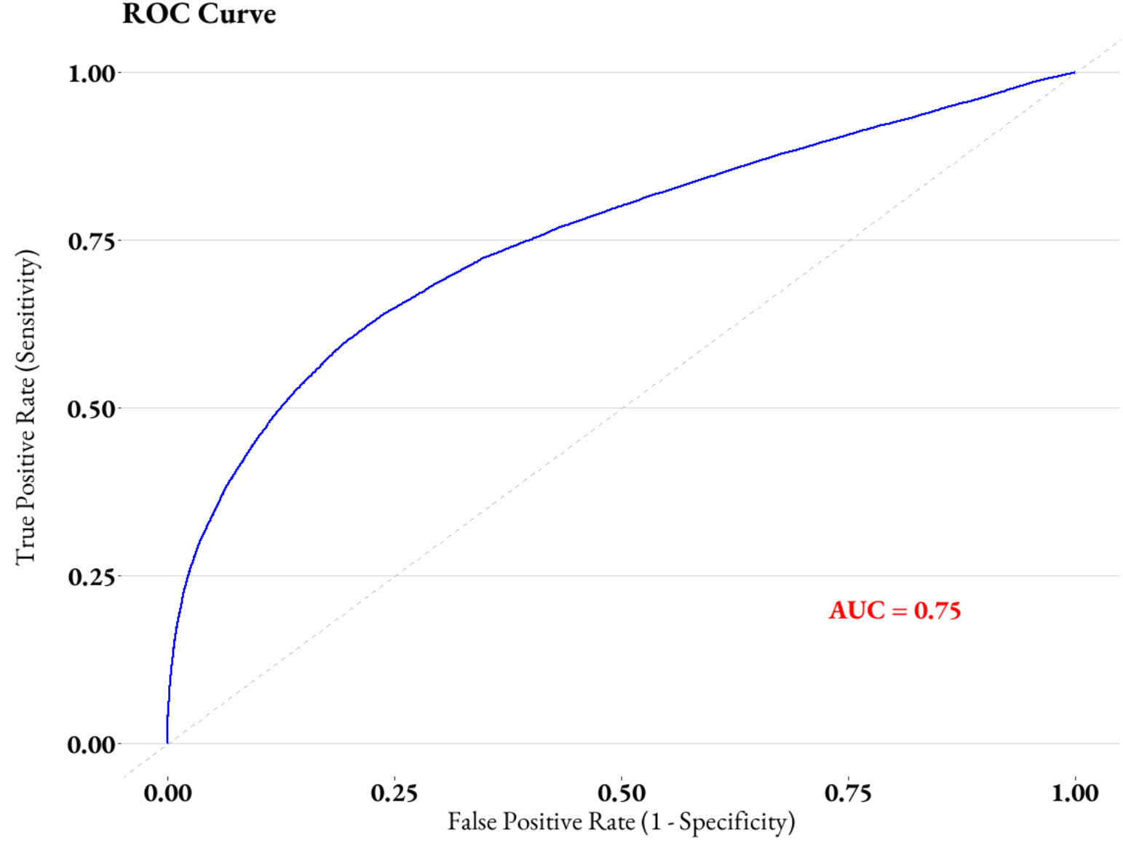
ROC Curve
Results and Insights

Slide 35
Performance Metrics Across Models
Results and Insights
Test Results | Model | Accuracy | F1-Score | Sensitivity | Specificity
 | Logistic Regression | 0.66 | 0.26 | 0.34 | 0.21
 | Random Forest | 0.72 | 0.16 | 0.50 | 0.10
 | XGBoost | 0.72 | 0.13 | 0.46 | 0.07
 | LightGBM | 0.72 | 0.09 | 0.53 | 0.05
Test Results | Model | Accuracy | F1-Score | Sensitivity | Specificity
 | XGBoost | 0.87 | 0.10 | 0.9901 | 0.7119
 | LightGBM | 0.8619 | 0.0188 | 0.9869 | 0.687
 | Random Forest | 0.8005 | 0.1822 | 0.9435 | 0.3246
 | Logistic Regression | 0.7161 | 0.1822 | 0.7131 | 0.5482

Slide 36
Performance Metrics Across Models
Results and Insights
Model | Accuracy | F1-Score | Sensitivity | Specificity
Logistic Regression | 0.66 | 0.26 | 0.34 | 0.21
Random Forest | 0.72 | 0.16 | 0.50 | 0.10
XGBoost | 0.72 | 0.13 | 0.46 | 0.07
LightGBM | 0.72 | 0.09 | 0.53 | 0.05
Rank | Model | Reasoning
1 | Logistic Regression | Highest sensitivity (0.21) and F1 score (0.26), suggesting better detection of positive cases.
2 | Random Forest | Moderate balance between sensitivity (0.10) and F1 score (0.16), higher specificity (0.10).
3 | XGBoost | Better balance of specificity (0.07) and accuracy (0.7173) but low sensitivity and F1 score.
4 | LightGBM | High specificity (0.9830) but very poor sensitivity (0.0487) and F1 score, limiting its utility.

Slide 37
Predicting Traffic Accident Damage Severity Using Machine Learning Models
Data Science Project – Statistical Modelling for Data Science Course
Sarthak Sunil Dhanke
12/12/2024

